Slide 1

Patient Registration from anywhere in the world

Slide 2

GPS Search and Nearby Health Center Association

Slide 3

Nearby Health Center attached with HealthID

Slide 4

Peoples Network Throughout The World

Slide 5
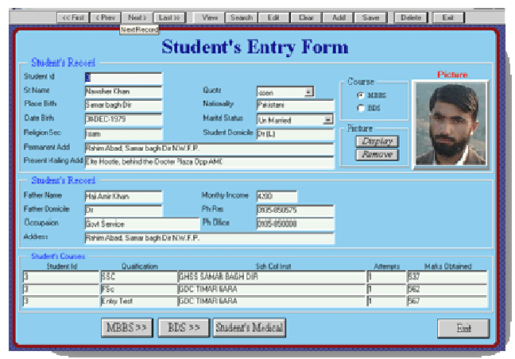
Personal Information/Registration are Same

Slide 6

Student are attached with School/College

Slide 7

Student Progress Tracing Throughout the Life

Slide 8

Data Analytics, Future Prediction and Career track

Slide 9

Patient Registration Doctor Chamber/CC

Slide 10
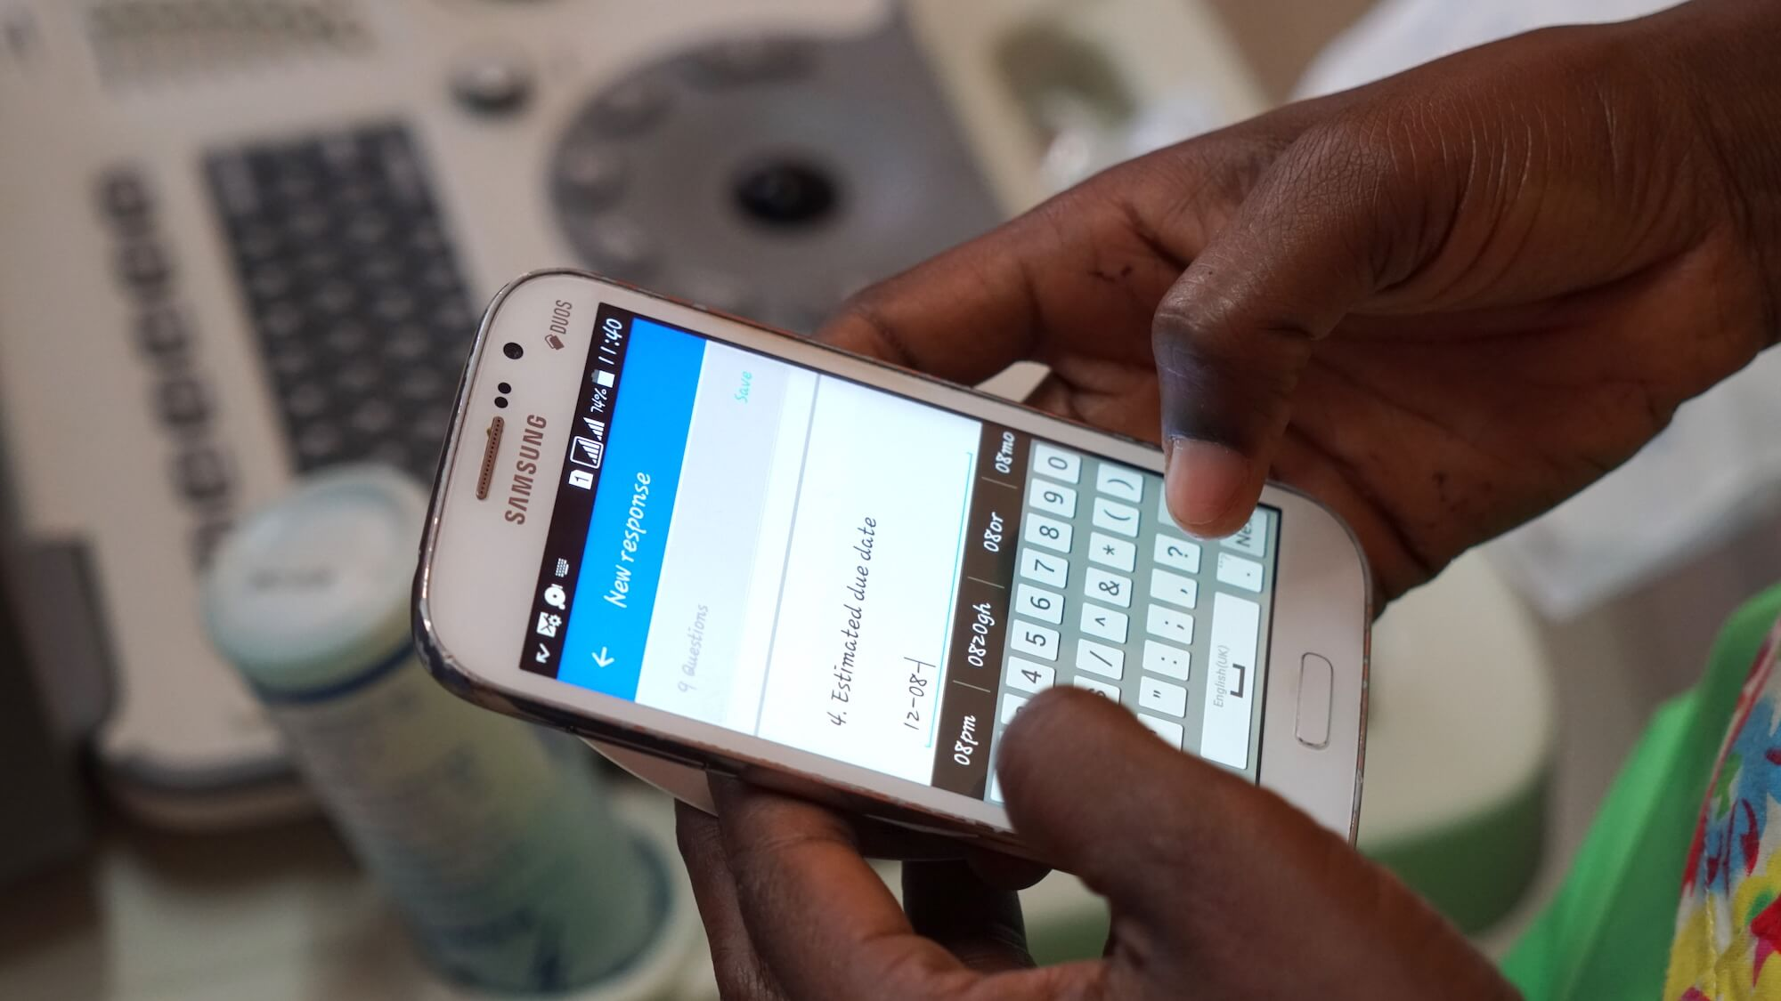
Patient/Student Registration

Slide 11
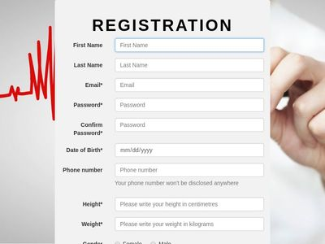

Slide 12

Updated Information Any time by CC
At Call Center.
During any entry.
By Patient Himselfe.

Slide 13
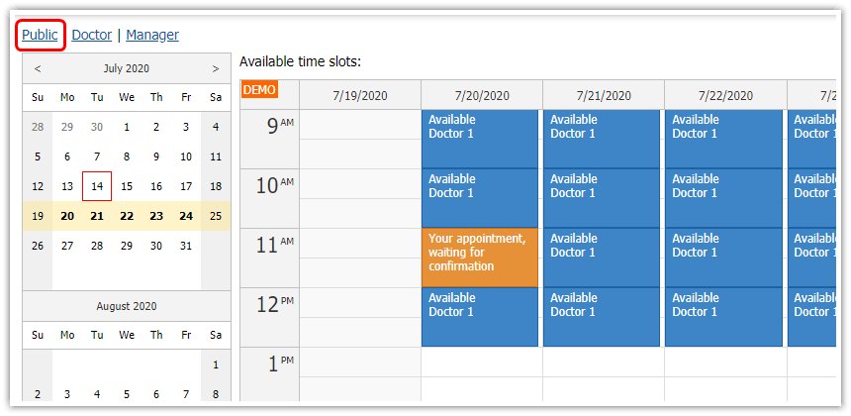
Doctors Appointment

Slide 14

Doctors Checking Appointment Any Time
From anywhere in the world.

Slide 15
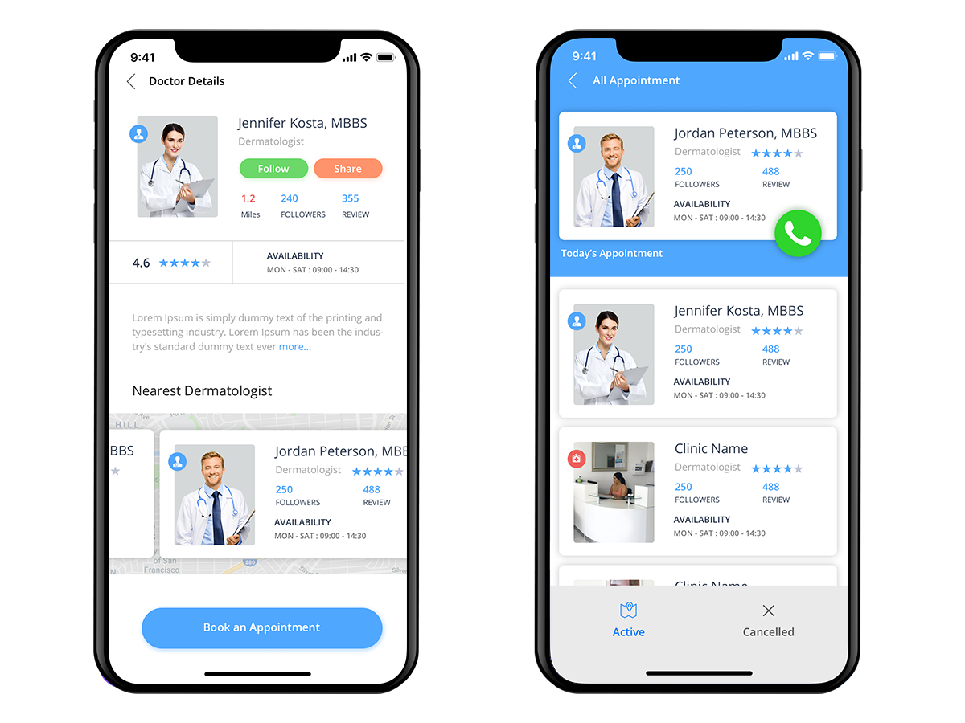
Doctors Appointment

Slide 16
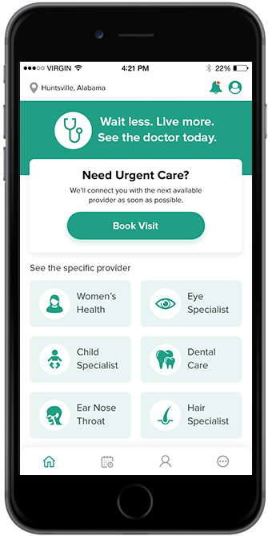
HealthNet Doctors In Clinic, During Appointment

Slide 17
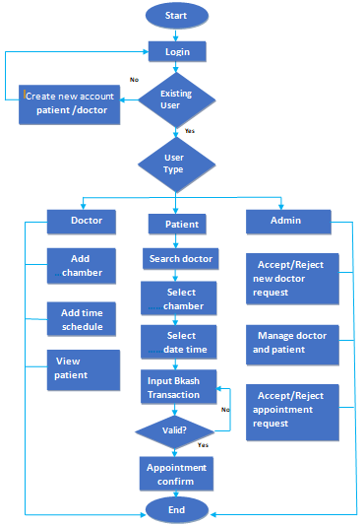
Flow chart of the doctor appointment system

Slide 18

HealthNet Doctors Assistance
HealthNet Call Agent Take all Necessary Info from Patient before the visit Start

Slide 19

HealthNet, Global Doctors Network

Slide 20
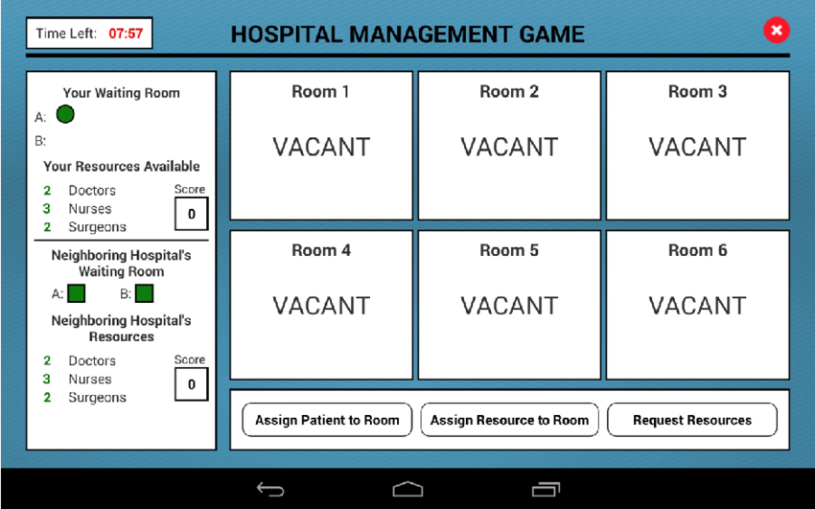
Patient Waiting at Doctors Chamber

Slide 21
Patient Visiting Doctor
Patient Basic Information Required Before Treatment
Patient Waiting After Appointment or all Appointment for the specific Doctor
Patient Sitting Before The Doctor. Required Info Can be available here.
Patient Waiting After Appointment. How many Patient Have Visited Doctor. Report on Visit Pay, etc.
Treatment Interface
Waiting Interface for all Software

Slide 22
Patient Treatment By Doctor
Patient Basic Information Required Before Treatment
Symptom
Examination
Investigation
Diagnosis
Prescription-1
Prescription-1
Treatment-2
Prescription-1
Prescription-1
Treatment-1
Prescription-1
Treatment-3

Slide 23



Call Agent for Patient Again

Slide 24





Slide 25

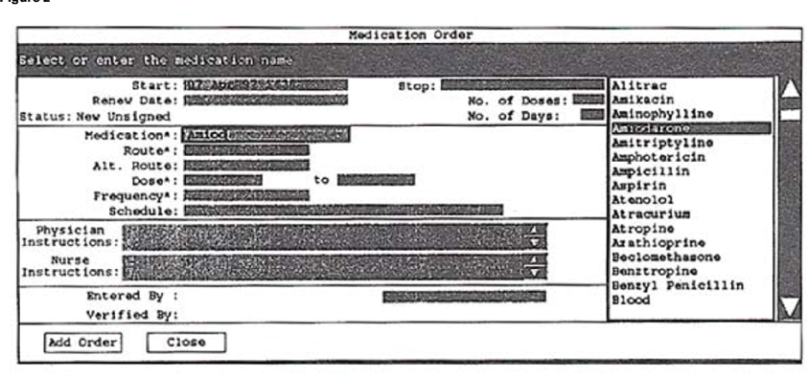
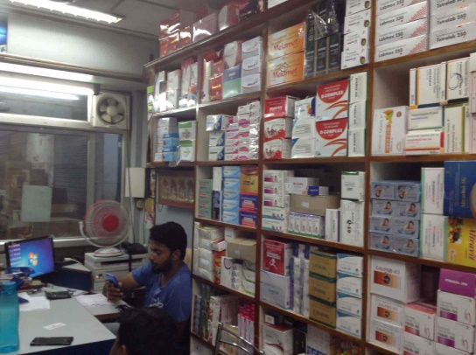
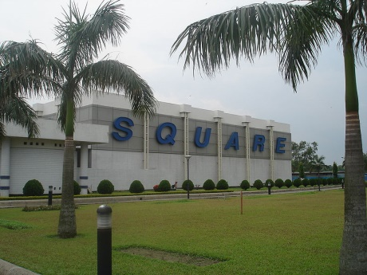
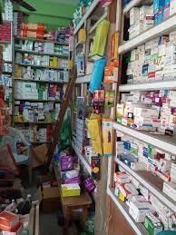
Medical store/Pharmacy Management System
HealthNet Database System
Data Available at Medical Store Using PNet
Order Shall be placed through the system.

Slide 26
Requisition form
Member Photo
Member Id
Email
Member Name
Phone
Member_Type
Member Address
Category | Brand | Product | quantity | Buying Price | Selling price
Comments
Payment Method
Add new row
Prepared by
Delivery Charge
Total
Date
BKash Charge
Email
Submit
Overhead Cost
Whatsapp

Slide 27


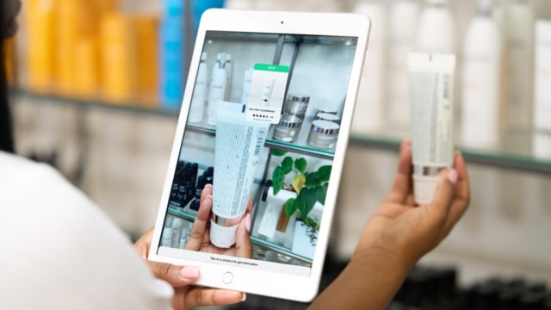
Medical store/Mobile Pharmacy

Slide 28
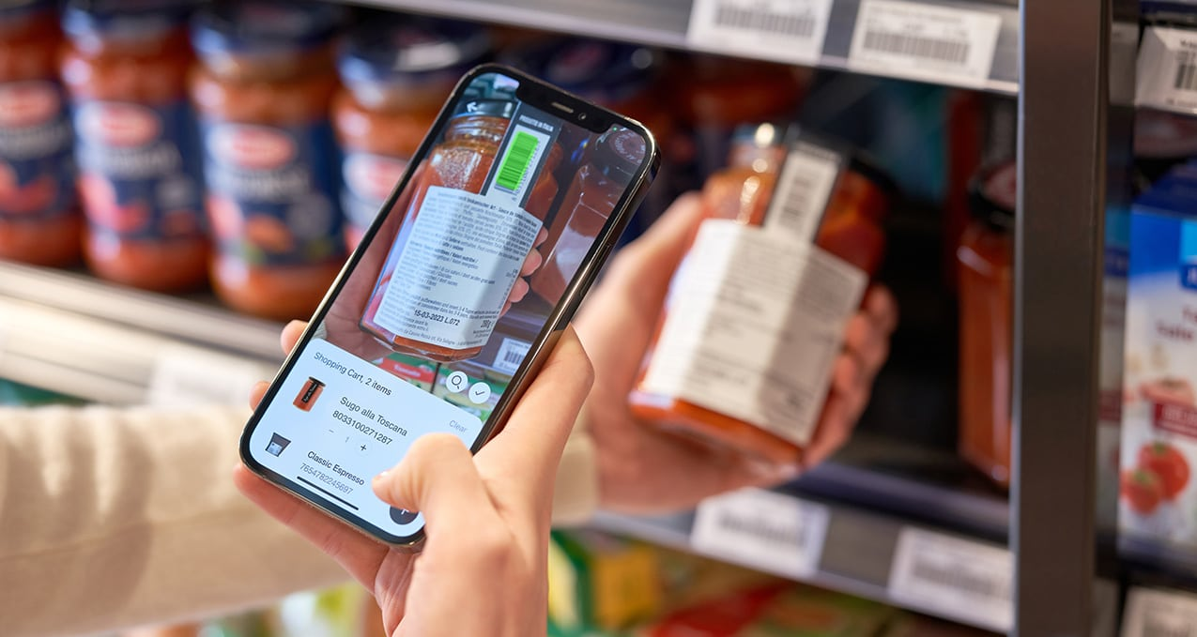
Recognize the shape

Slide 29
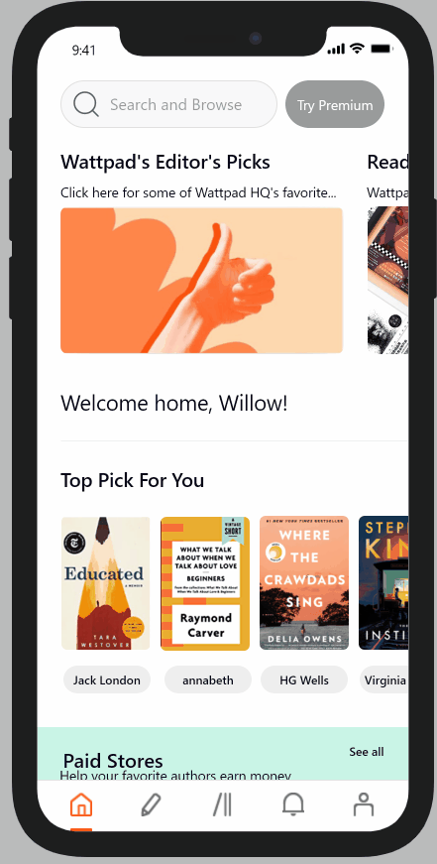

100

Slide 30

||||||||||||||||A3B5
100

Slide 31
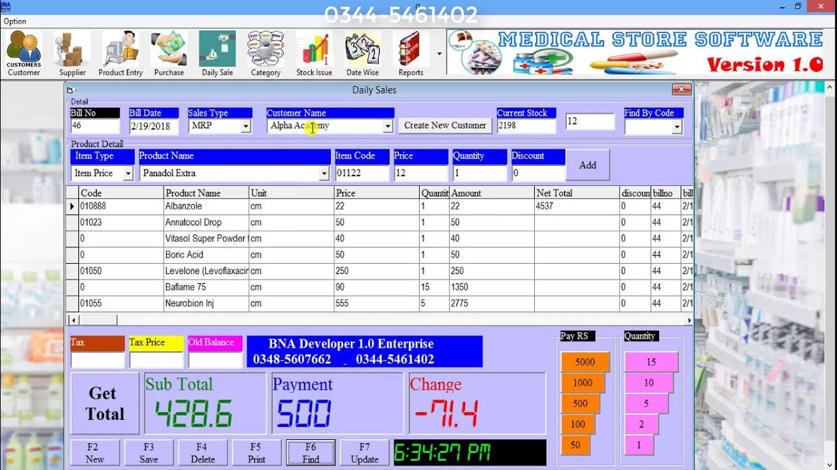
Drug Store POS
https://www.youtube.com/watch?v=v6m8AKddZDA

Slide 32
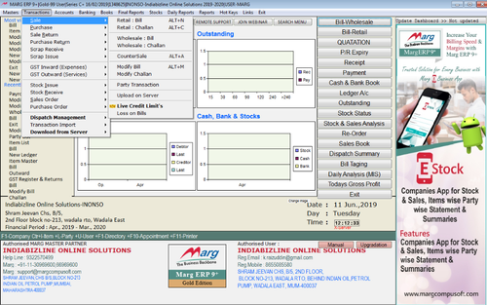

Slide 33
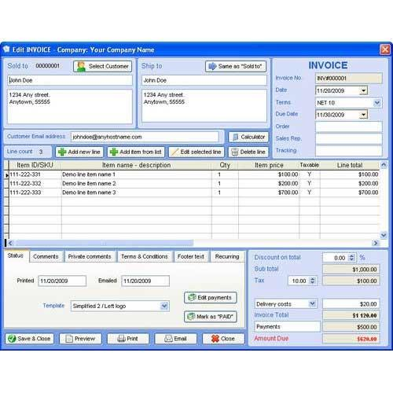

Slide 34
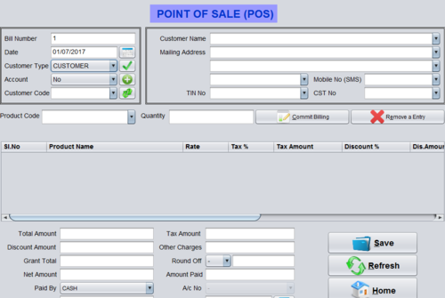

Slide 35
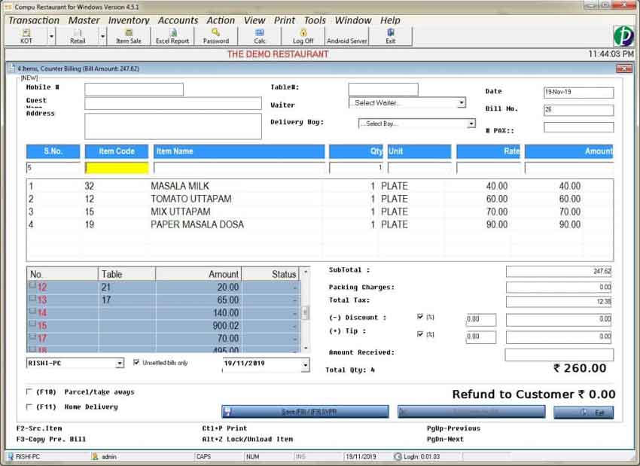

Slide 36
https://www.websysinfotech.in/retail-management-system/
Retail Management System

Slide 37
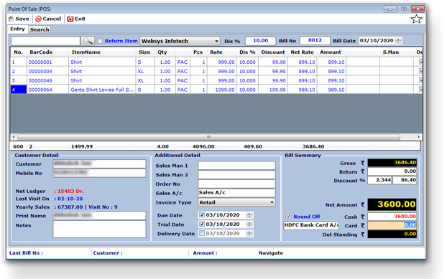
Sales

Slide 38
Sales Invoice POS Invoice – Thermal Printer, Laser Printer Sales Return In Running Invoice Customize Invoice printing Barcode, Item Search, Weight Scale Integration with POS Auto WhatsApp & SMS Functionalities For Invoice To Customers and Owner. Pole Display, Cash Drawer Integration Quick Add customer details from POS Home Delivery Management Salesman Commission Management Price Level Item & Invoice Level Discount Option. Loyalty / Discount Program with user define criteria. Multiple Invoices (Hold / Release). User Operation (Edit, Delete, Change Prince, Discount) Rights. Multiple Payment Modes. (Cash, Bank, Outstanding, Wallet) Customer Sales History Fast Billing Supported weight Scale integration with POS. Quotation

Slide 39
Purchase & Order
Direct Purchase Order To Purchase Entry. Facility to define MRP, Retail Rate & Wholesale Rate from Purchase Entry. Rate History at time of purchase Multiple Size Entry. Easy & Fast purchase entry with predefine Item EAN Code and Barcode Facility to Save Physical Purchase Invoice copy. Import Facility. Auto Barcode Generation from Purchase Purchase Return Management Define Stock Point at time of purchase. Due Date Reminder for Credit Purchase Invoice. Customize Barcode Format. Gross Rate, Discount Percentage, Discount Amount, Extra Discount Percentage, Extra Discount facility on purchase item entry. Auto Accounting & Inventory Management

Slide 40
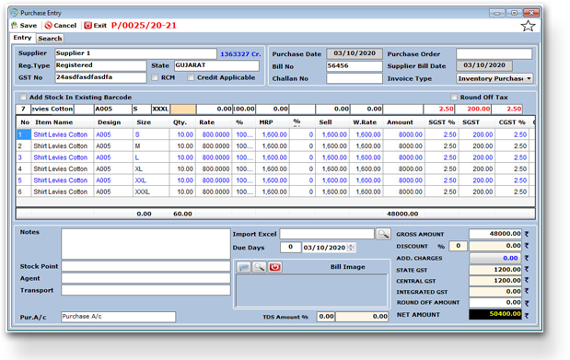

Slide 41
Inventory Management
Detailed Product Master. Multiple bifurcations in product like Category, Department, Brand, Style, Packet Size etc. Batch Number & Expiry Date Management. EAN Barcode, Self Define Barcode on Inventory. Serialized Barcode support. Barcode printing on Laser and Barcode Printer. Inventory Search by Barcode, Item Name, Batch No, Expiry Date, MRP etc. Business Analysis Reports for Inventory. Production & Consumption Entry. Physical Stock Verification. Item Level Definition of Tax. Facility to set Item Image. Facility to Set Ingredients on item definition. Item wise stock inward outward details. Manage stock point wise inventory. Stock Point transfer entry. Stock summary report with opening, inward, outward and closing balance with cost price and MRP valuation.

Slide 42
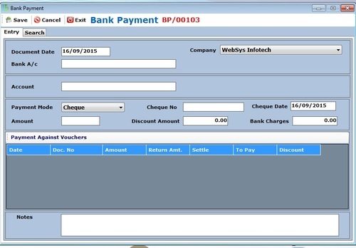

Slide 43
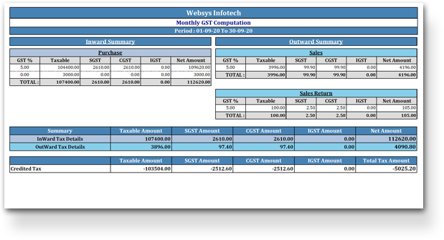
TaxationTaxation

Slide 44
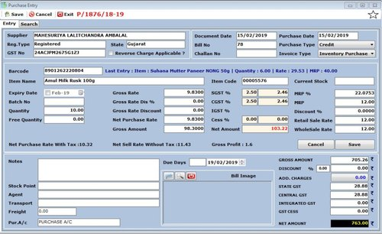

Slide 45
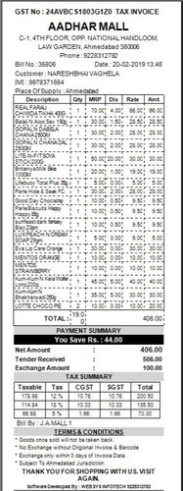

Slide 46
Pricing Management
MRP, Retail Rate and Wholesales Rate Management. Customer Wise Rate Management. Easy to implement discount on items.

Slide 47
Complete Integration of Taxation System, Easy to set, Maintain and Update Tax Rate on Items. Return filling reports and export files.

Slide 48
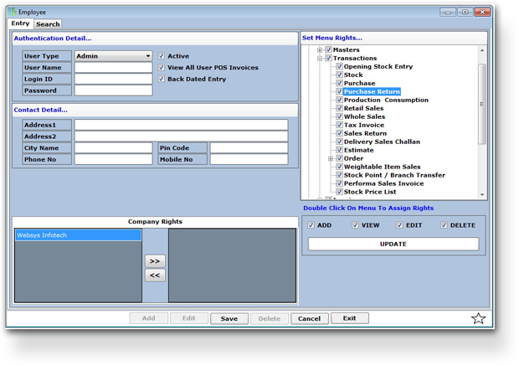

Slide 49
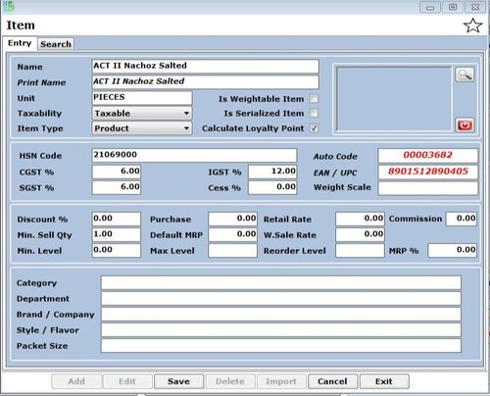

Slide 50
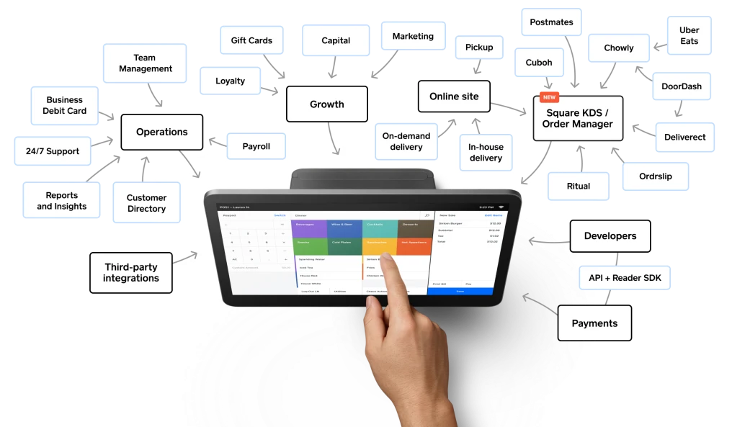
Restaurant POS

Slide 51
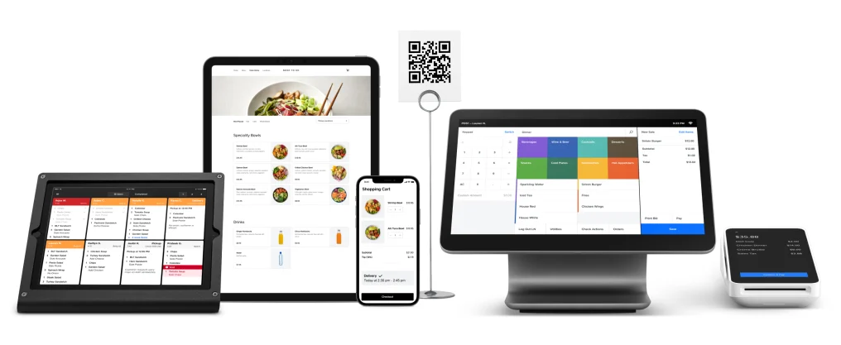
Design Must be for All Devices

Slide 52
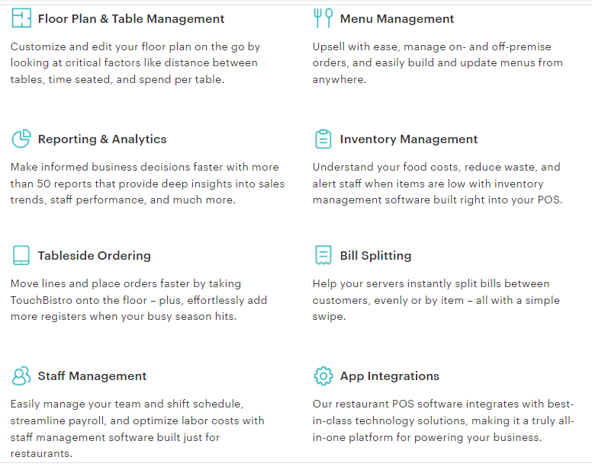
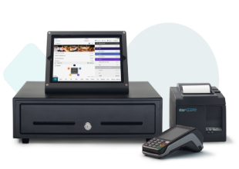
https://www.touchbistro.com/merchant-maverick/?utm_medium=referral&utm_source=merchantmaverick&subid=24376-best-restaurant-pos-systems_bo_top-table&lead_reference_number=1026c8f5024e6365f2e0511d378782
POS Features

Slide 53
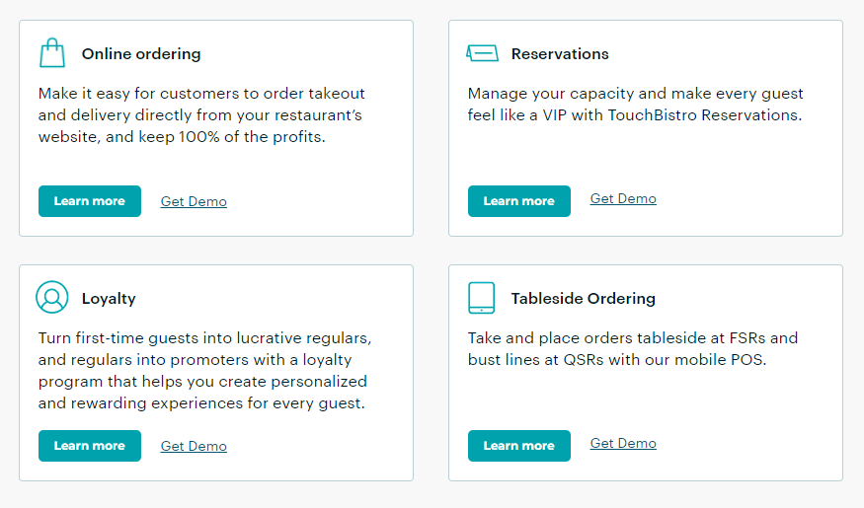

Slide 54
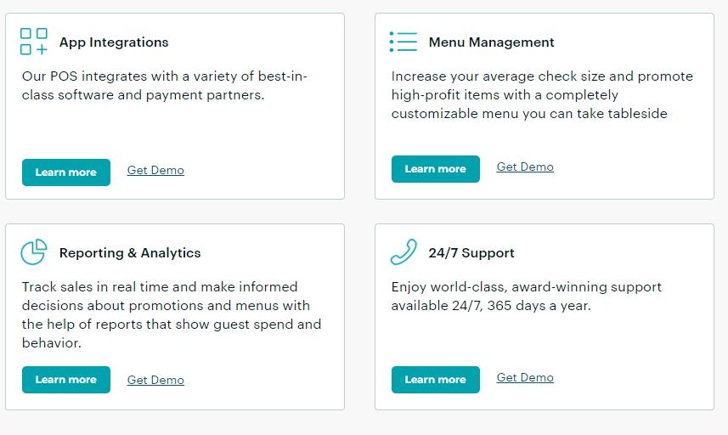

Slide 55
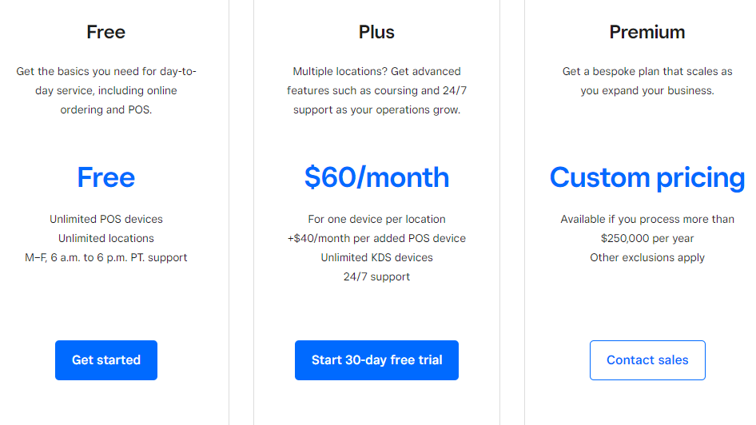

Slide 56
RMG/Clothing Store POS

Slide 57
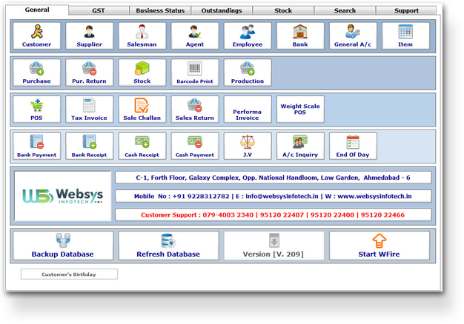
Multi Company & Users Management
Multi Company Management with user access rights. Stock Transfer Facility. Single Invoice Entry For Multi Company Items.

Slide 58

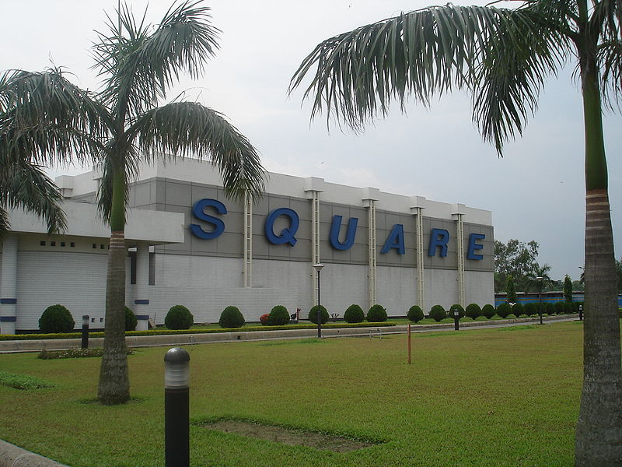

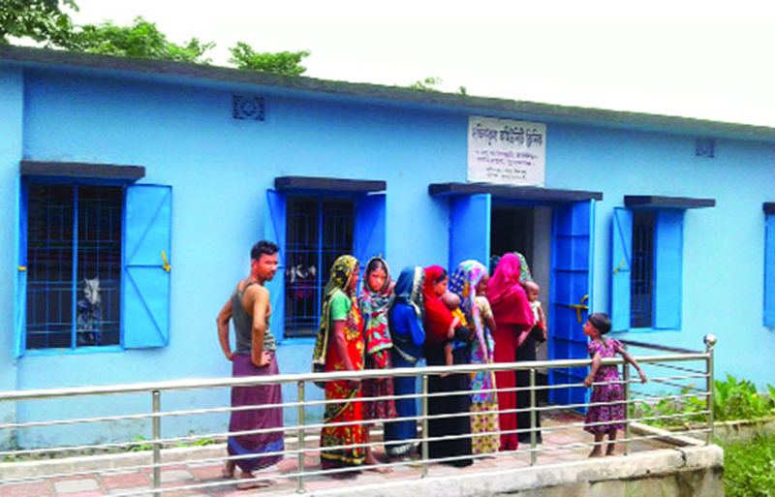

Slide 59
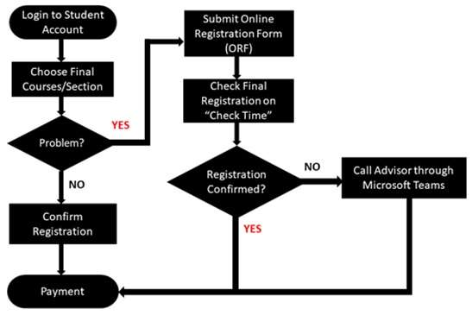

Slide 60
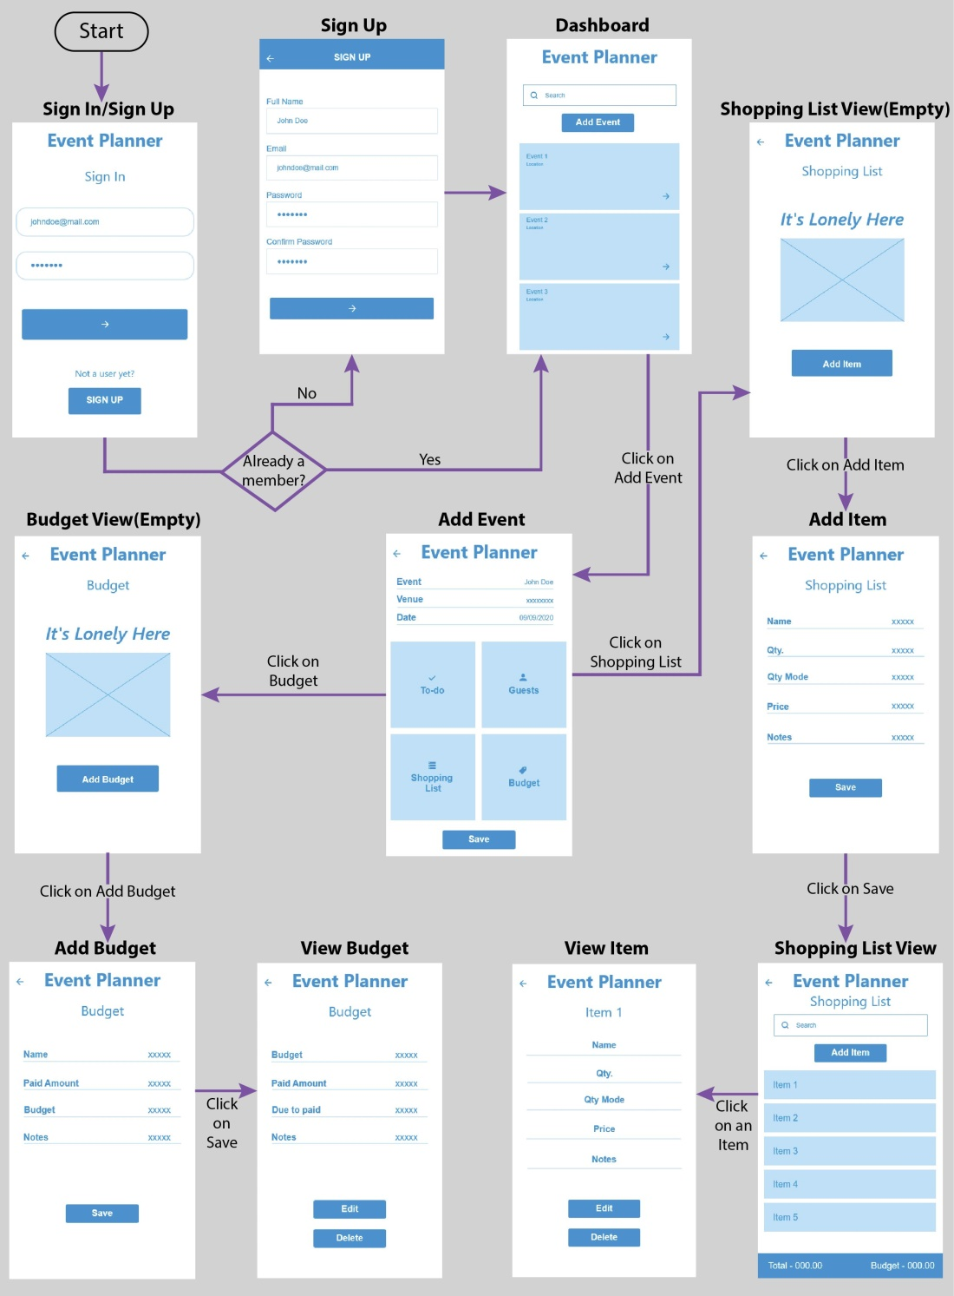

Slide 61
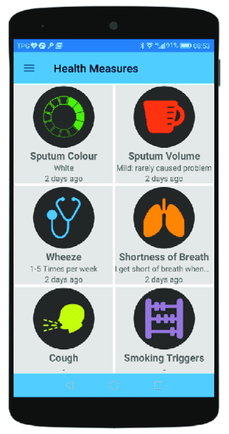
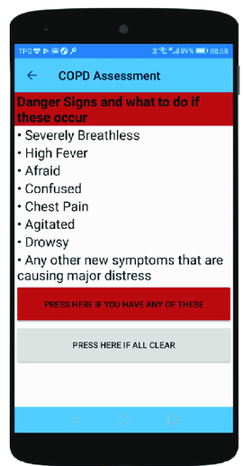
Doctor’s Interface

Slide 62
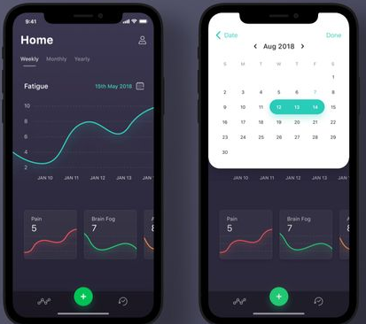
Symptom Tacker Interface

Slide 63
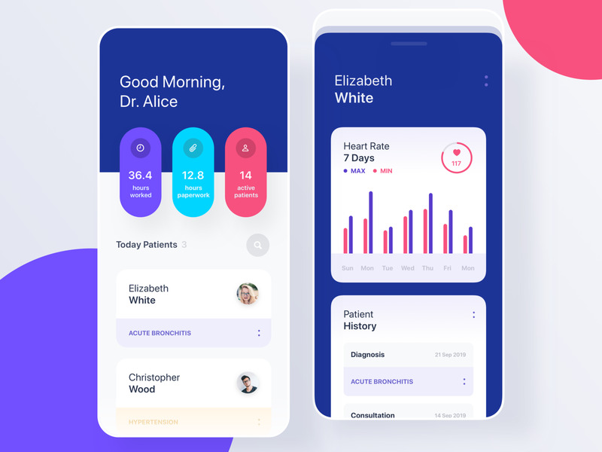
Notification to The Doctor

Slide 64

Possible Health Assistance for Doctor

Slide 65


Slide 66
Patient Management
Cabin/Bed Management
Accounts Management

Slide 67




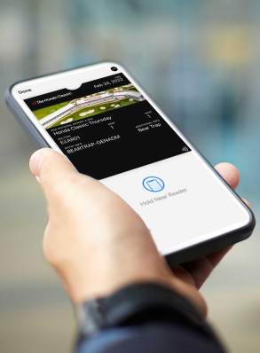




Relationship Observation Patient

Slide 68






Relationship Observation Student
Parent

Slide 69




Relationship Observation Professionals
Senior
Team
Job Assignment

Slide 70


Relationship Observation Entrepreneurs
Client

Slide 71
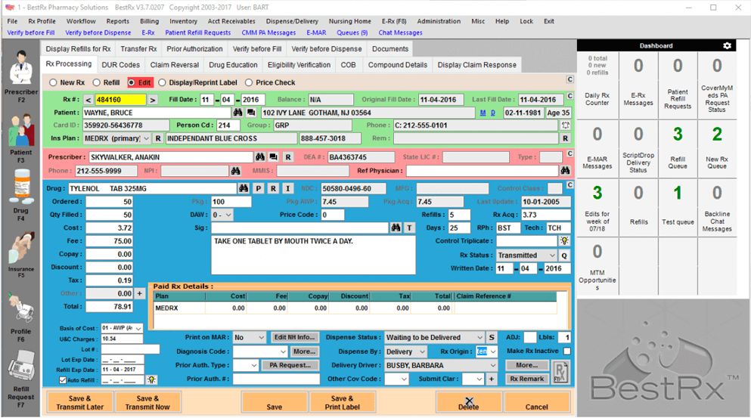
BestRx

Slide 72
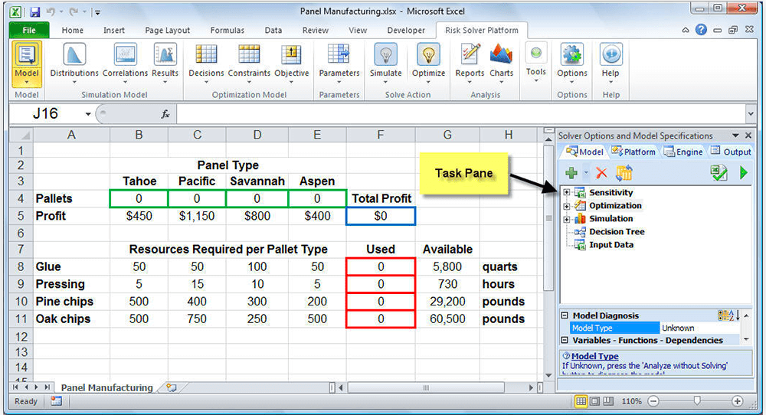

Slide 73

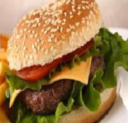


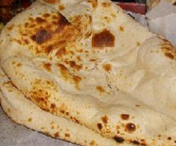
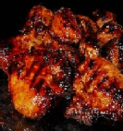

Food Calculator
Customer
Save
Mobile
Waiter
Table
230
2
280
5
280
3
480
2
560
2
Item
Total
VAT
Total

